Slide 1

Campus Placement Data Analysis
Sia bhowmick

Slide 2
Contents
Background
EDA
Conclusion

Slide 3
Overview
The dataset consists of campus placement data for MBA Business Analytics students from a university in India. There are 215 observations and 15 variables
Dataset has information on:
placement status of the student
salary offered to students who were placed
MBA specialization and grade
Record of previous employment
specialization and grade for undergraduate, higher secondary, and secondary education

Slide 4
List of Variables
sl_no: Serial Number of the observations for each student
gender: Male = ‘M’; Female = ‘F’
ssc_p: Secondary Education percentage (10th grade)
ssc_b: Board of Education for Secondary (Central / Others)
hsc_p: Higher Secondary Education percentage (12th grade)
hsc_b: Board of Education for Higher Secondary (Central / Others)
hsc_s: Specialization in Higher Secondary Education (Commerce / Science / Other)
degree_p: Degree Percentage
degree_t: Under Graduation degree type (Field of education)
workex: Record of previous work experience (Yes / No)
etest_p: Employability test percentage (conducted by college)
specialisation: Post Graduation (MBA) specialization (Mkt&Fn / Mkt &HR)
mba_p: MBA percentage
status: Status of placement (Placed / Not Placed)
salary: Annual salary offered by corporate to candidates who were placed

Slide 5
Exploratory Data Analysis

Slide 6
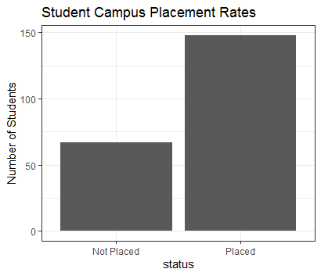
More students were placed than not placed
Not Placed: ~31%, Placed: ~69%.

Slide 7
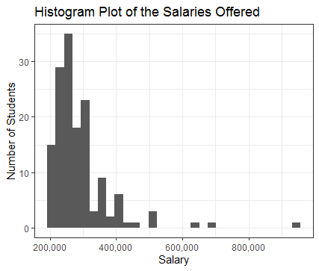
Annual salaries for students who received an offer (currency: Rupees).
Range from approx. Rs.200,000 to Rs.950,000.
Median salary is Rs.265,000.

Slide 8
Based on superficial inspection of the variables, the following hypotheses have been formed
Variables likely to influence status
Variable unlikely to influence status
mba_p
specialisation
etest_p
workex
degree_p
degree_t
gender
ssc_p
ssc_b
hsc_p
hsc_b
hsc_s

Slide 9
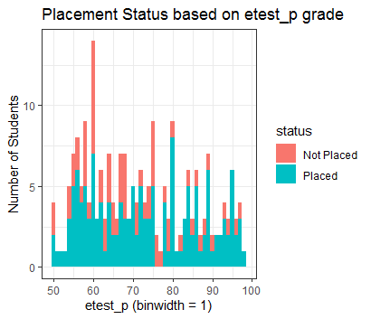
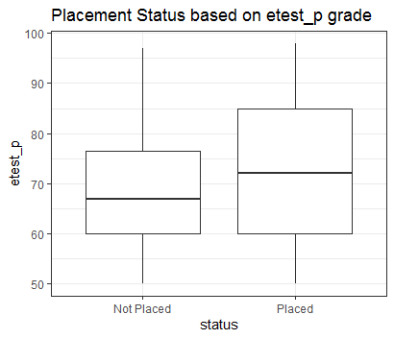
Histogram plot hints that the percentage of placement is larger for students with higher employment test score, but the trend is not evident.
Boxplot shows the etest_p score for students who were not placed in the range 60-76, and for those placed in the range 60-85. Therefore, it is certain that students with high etest_p scores were placed, but those with scores 60-76 who were also placed, there must be other factors that influenced it.

Slide 10
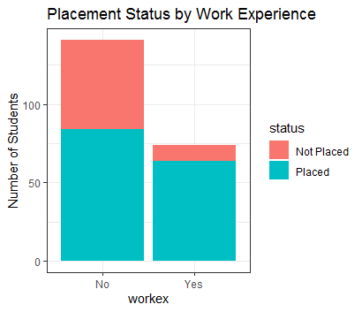
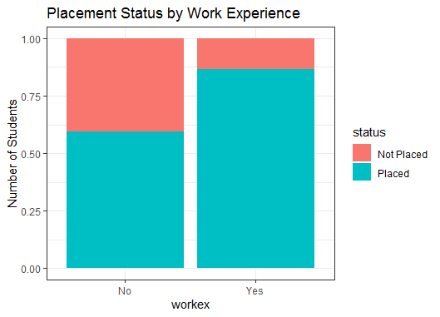
Significantly more students without previous work experience.
90% of students with previous work experience got placement.
60% of students without work experience were placed.

Slide 11
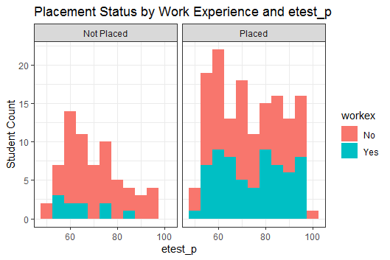
Students with work experience who were not placed definitely have lower employment test score.
However, for the students who were placed, etest_p scores do not seem to have any effect on the placement decision.

Slide 12
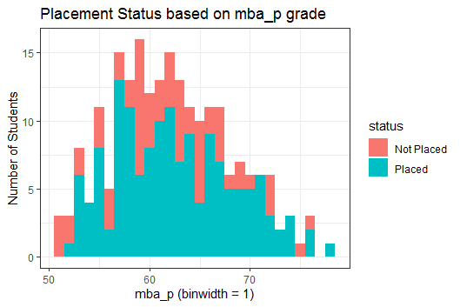
The initial hypothesis for MBA exam grade holds true for the lowest and highest range of scores.
But the visual evidence is not strong for the scores in the middle.

Slide 13
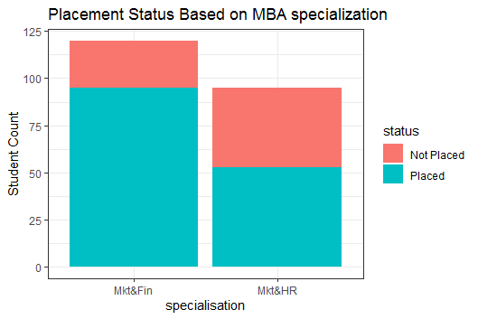
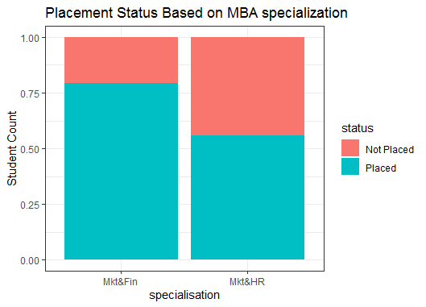
More students specialized in Mkt&Fin than Mkt&HR.
More candidates with Mkt&Fin were hired.

Slide 14
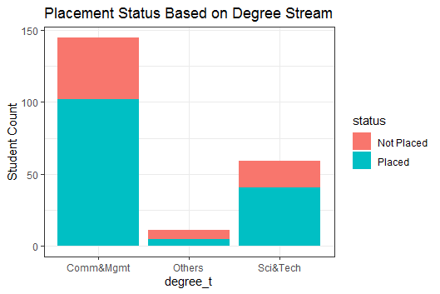
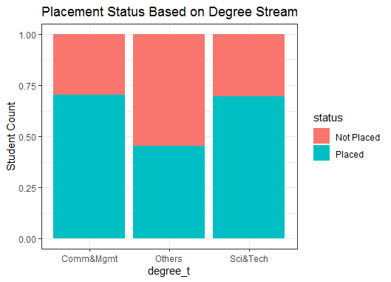
Roughly 70% of students from Comm&Mgmt and Sci&Tech were placed.
Less than 50% of students from other degree streams were placed.

Slide 15
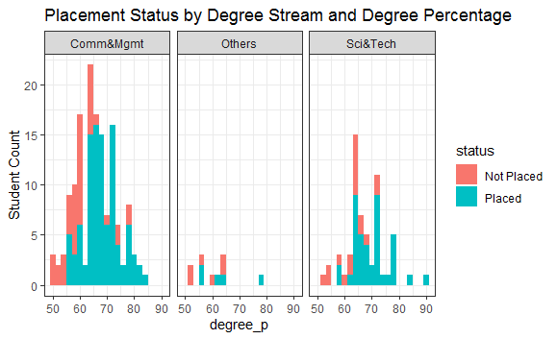
Regardless of the stream, students with higher degree percentages were preferred.

Slide 16
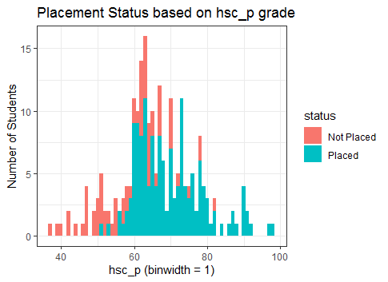
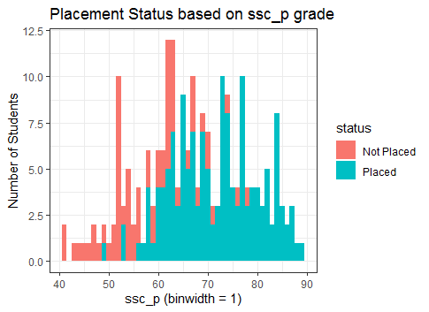
Students with higher secondary and higher secondary percentages were preferred for placement.

Slide 17
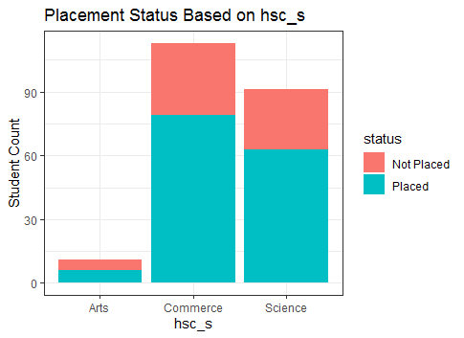
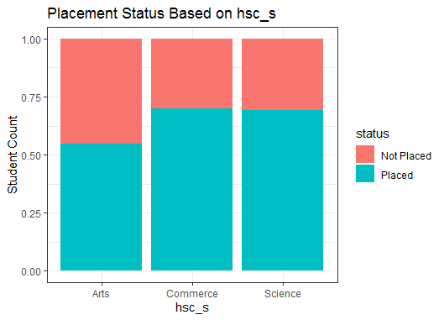
Trend here is similar to what was observed for the degree streams

Slide 18
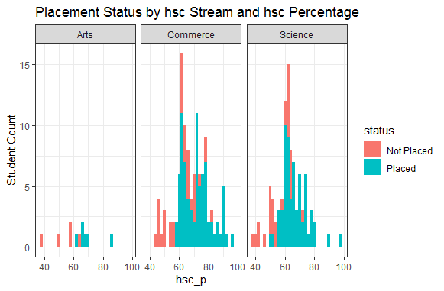
Trend here is similar to what was observed for the degree streams and percentages
Students with higher hsc scores, regardless of the stream, were preferred for placement.

Slide 19
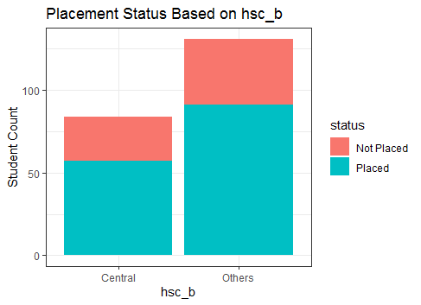
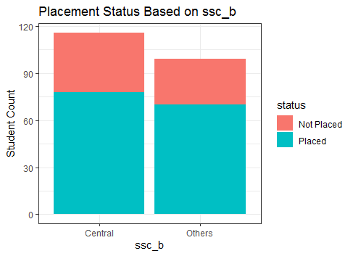
There does not seem to be any evidence to suggest one board is preferred than the other.

Slide 20
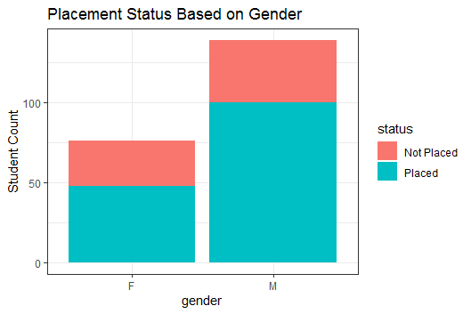
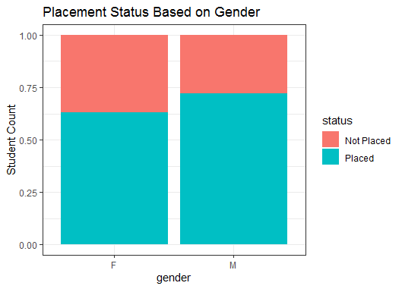
More male students than female.
Similar percentage of placement for male and female students.

Slide 21
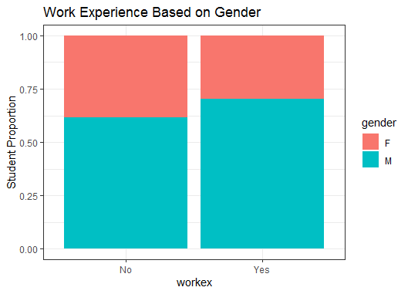
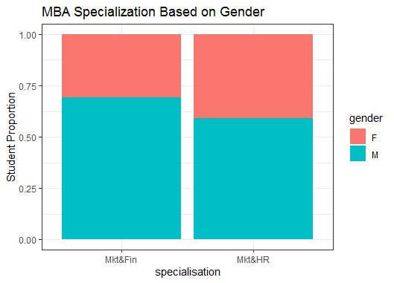
A little less female students with work experience than male.
More females in Mkt&HR than Mkt&Fin.

Slide 22
Recap
At this point in the analysis it was noticed a higher preference for students who specialized in Mk&Fin for their MBA, previous work experience, and those who had higher scores for secondary, higher secondary, and undergrad.
The results showed more male students than female who were enrolled in the MBA program. The plots with respect to gender showed that less female students were placed, which could be attributed to more male than female students with more work experience. There were more female students in the Mkt&HR program and more male students in the Mkt&Fin program.
The possibility is also that historically, men tend to have more successful interviews than women as women tend to be not as vocal about their achievements as men. Women also tend to underestimate their achievements and capabilities.

Slide 23
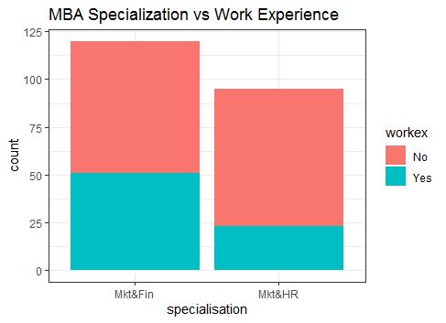
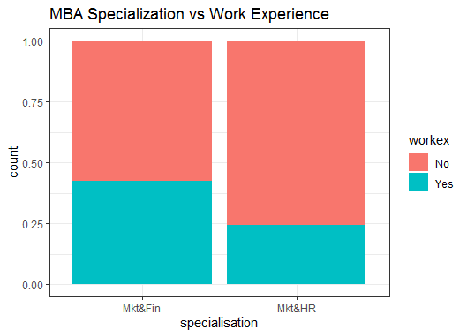
More students in Mkt&Fin with work experience than those in the Mkt&HR specialization.

Slide 24
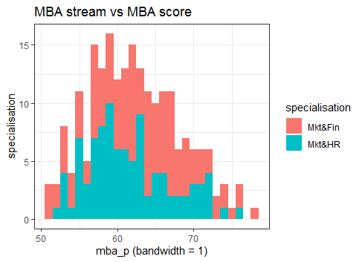
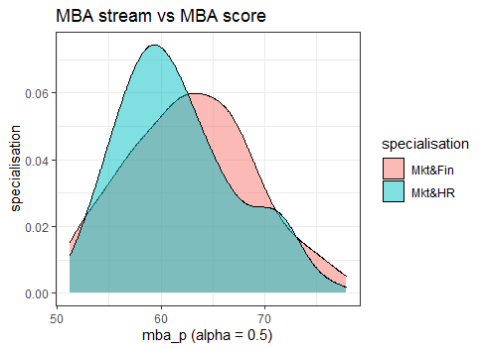
The MBA score trend for both specializations seem to be following the same trend. But the density plot shows more candidates in Mkt&HR had lower scores.

Slide 25
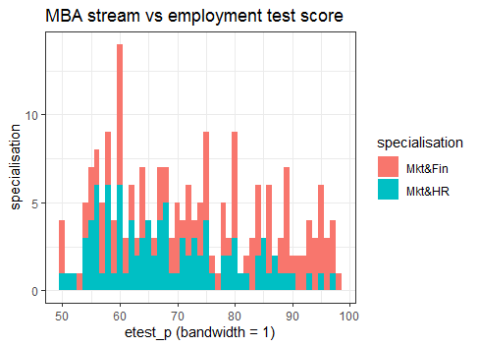
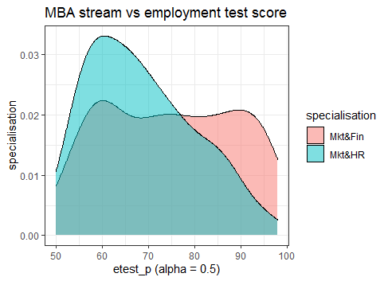
More students in Mkt&HR had lower employment test scores.

Slide 26
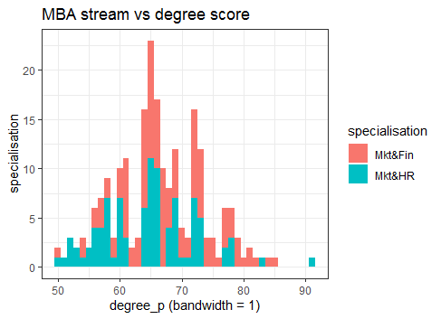
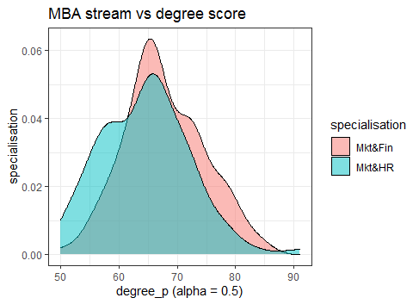
The histogram plot shows that students with Mkt&HR had lower degree scores, and more students specializing in Mkt&Fin scored higher.

Slide 27
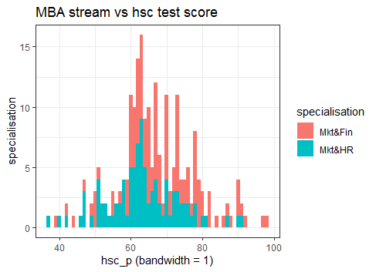
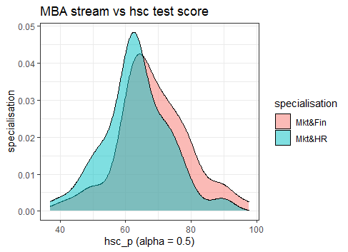
The difference in test scores for hsc_p was not noticeable for students in different MBA specialization.

Slide 28
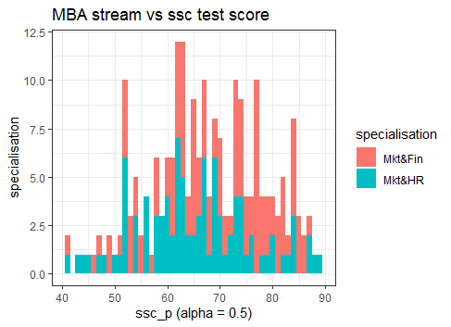
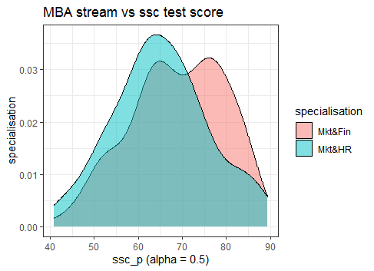
Although a higher number of Mkt&Fn students scored between 75-90, we can conclude no noticeable difference based on students’ specializations as more students are enrolled in Mkt&Fin than Mkt&HR.

Slide 29
EDA Summary
In general, students with previous work experiences and higher test scores in secondary, higher secondary, and degree final exams were preferred.
Students who specialized in Marketing and Finance were preferred to those who specialized in Marketing and HR.
Marketing and HR students had consistently lower scores for MBA test score, employment test score, and degree test score.
Less students specializing in Marketing and HR had work experience.
This showed that test scores and previous work experiences were two important deciding factors for the placement decision.

Slide 30
Next Steps
How does the annual salary offered depend on the other variables
Model fitting: Linear or Logistic Regression

